Slide 1
HW_Assignment_Final
File created on: 12/19/2025 6:47:42 PM

Slide 2
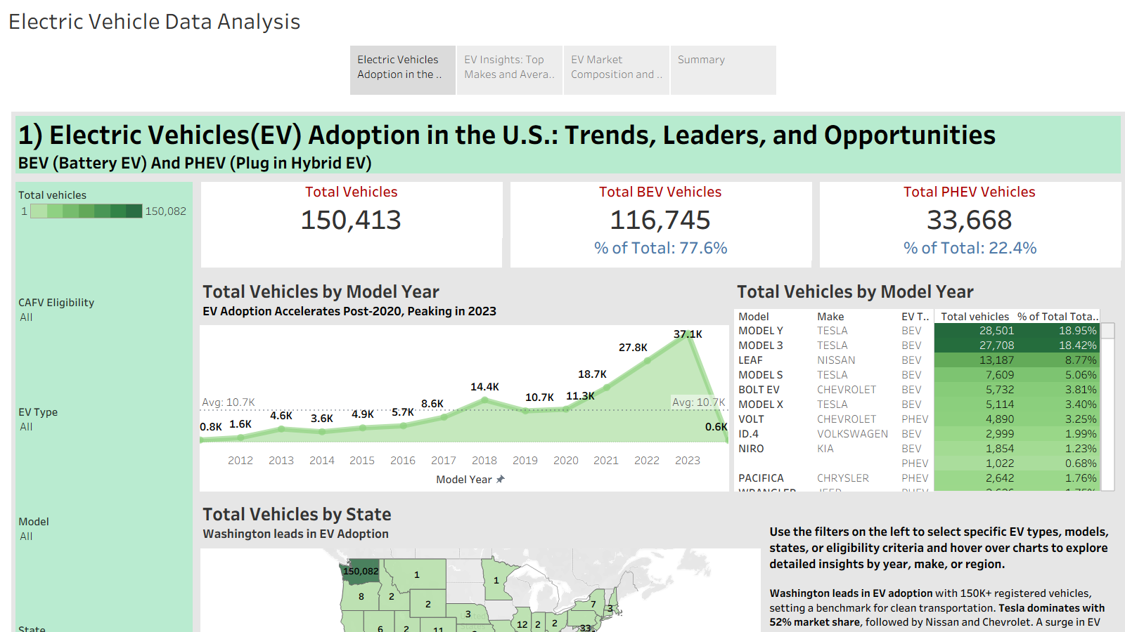

Slide 3
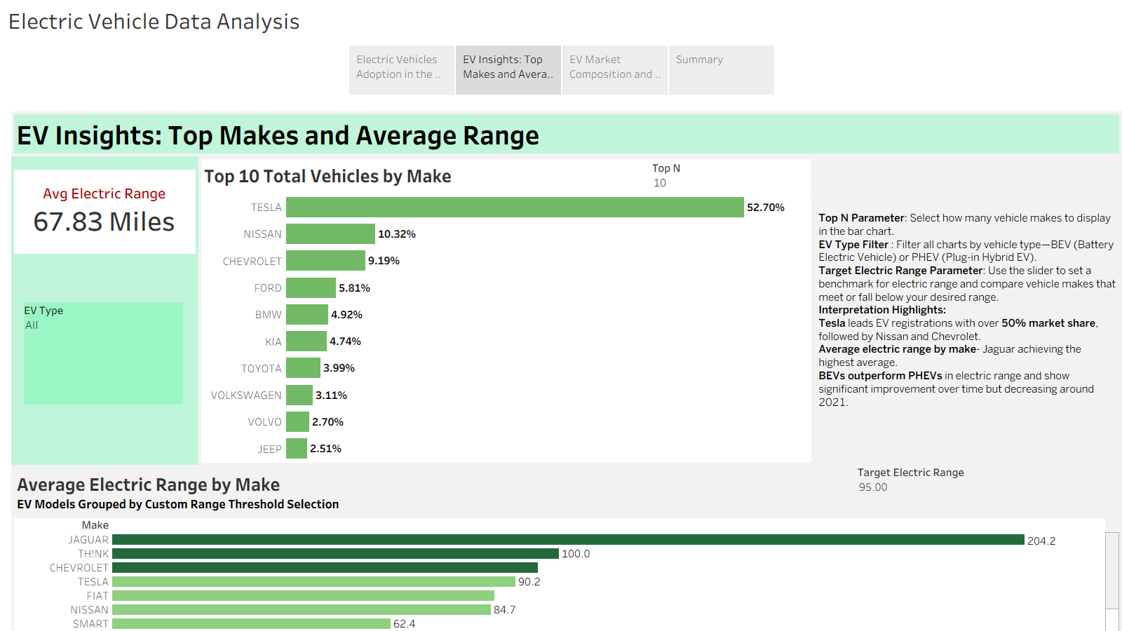

Slide 4
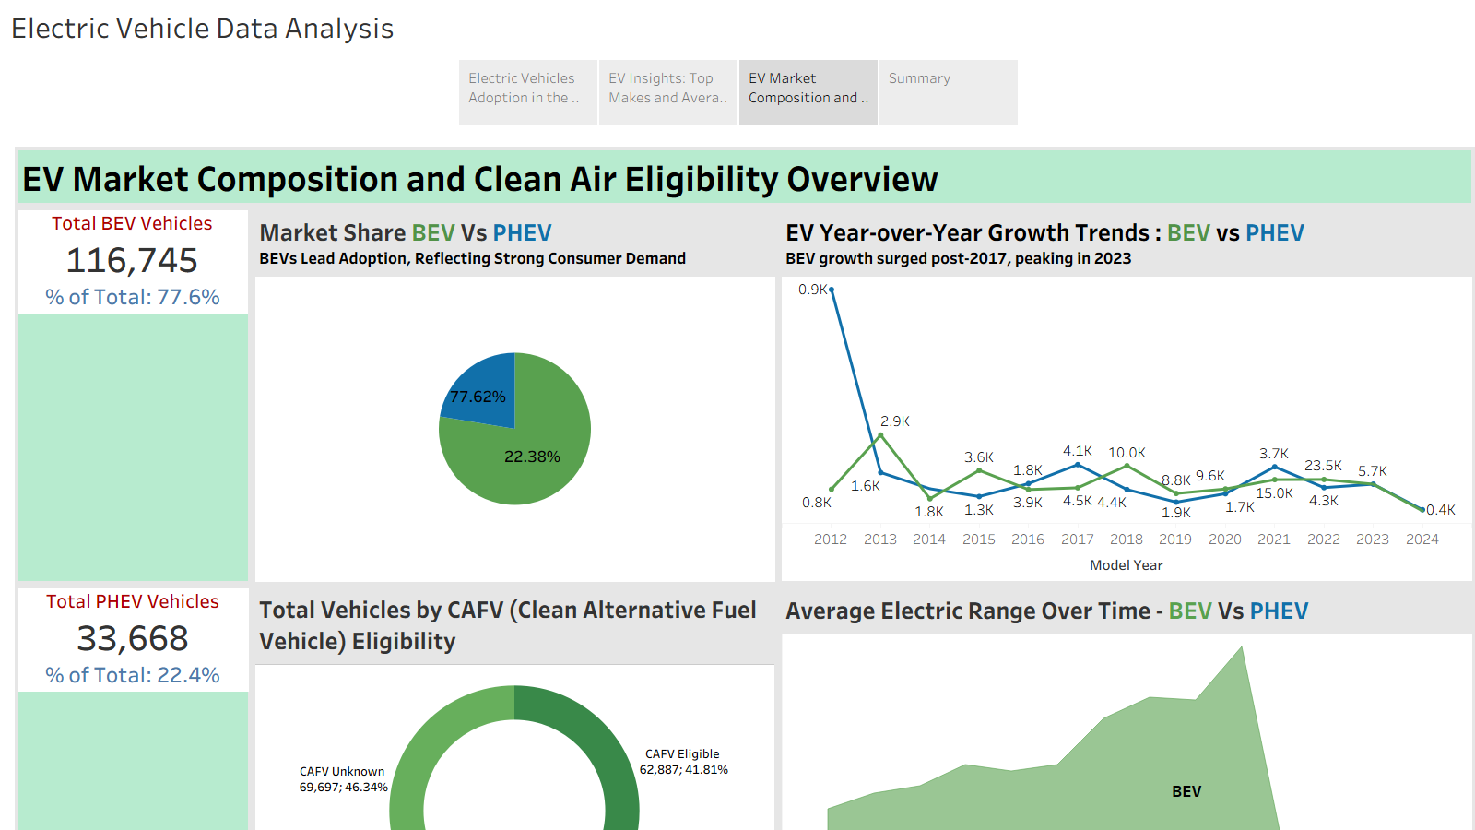

Slide 5
